Slide 1
Generating Data Augmentation Queries Using Large Language Models
1st International Workshop on Databases and Large Language Models
Christopher Buss, Jasmin Mousavi, Mikhail Tokarev, Arash Termehchy, David Maier, Stefan Lee

Slide 2





Drug Repositioning Can Save Lives
[Rare Daily Staff 2023] & [Ashburn & Thor 2004]
Patients with Castleman’s disease
Rare disease
Potentially fatal: causes severe inflammation
No effective treatments currently exist
Biomedical
Researcher
Unfortunate reality:
Too rare: no financial incentive for companies to develop treatments
Alternative:
Find an existing drug to treat Castleman’s disease

Slide 3
Identify a Candidate Drug
[Rare Daily Staff 2023] & [Ashburn & Thor 2004]
Find a candidate drug
FDA-Approved Drugs
Castleman’s causes severe inflammation…
brand_name | class | uses
Humira | TNF inhibitor | rheumatoid arthritis …
Enbrel | TNF inhibitor | plaque psoriasis …
Humira is used to treat conditions involving severe inflammation
Biomedical
Researcher
Candidate drug: Humira
Local Data Source
Next step: gather more information about Humuria:
Will it help or hurt?
Notes:
Irresponsible to just give it to patients…

Slide 4
Find External Sources
[Rare Daily Staff 2023] & [Ashburn & Thor 2004]
Local entity:
Generic Drugs
brand_name | class | uses
Humira | TNF inhibitor | rheumatoid arthritis …
generic_name | adverse_effects
Adalimumab | After treatment with adalimumab …
Etanercept | Etanercept binds specifically to tumor …
External Data Source
FDA-Approved Drugs
Bio Compounds
brand_name | class | uses
Humira | TNF inhibitor | rheumatoid arthritis …
Enbrel | TNF inhibitor | plaque psoriasis …
formula | mechanisms
C₆₄₂₈H₉₉₁₂N₁₆₉₄O₁₉₈₇S₄₆ | Binds with specificity to tumor …
C₂₂₂₄H₃₄₇₅N₆₂₁O₆₉₈S₃₆ | There are two distinct receptors …
Local Data Source
Biomedical
Researcher
External Data Source
Notes:
A-duh-lim-muy-mab
Explain datasets

Slide 5
What we Want: Info Relevant to Humira
[Rare Daily Staff 2023] & [Ashburn & Thor 2004]
Local entity:
Generic Drugs
brand_name | class | uses
Humira | TNF inhibitor | rheumatoid arthritis …
generic_name | adverse_effects
Adalimumab | After treatment with adalimumab …
Etanercept | Etanercept binds specifically to tumor …
Relevant
external
entities
External Data Source
FDA-Approved Drugs
Bio Compounds
brand_name | class | uses
Humira | TNF inhibitor | rheumatoid arthritis …
Enbrel | TNF inhibitor | plaque psoriasis …
formula | mechanisms
C₆₄₂₈H₉₉₁₂N₁₆₉₄O₁₉₈₇S₄₆ | Binds with specificity to tumor …
C₂₂₂₄H₃₄₇₅N₆₂₁O₆₉₈S₃₆ | There are two distinct receptors …
Local Data Source
Biomedical
Researcher
External Data Source
Notes:
A-duh-lim-muy-mab

Slide 6

Augment Humira With that Relevant Info
[Rare Daily Staff 2023] & [Ashburn & Thor 2004]
Generic Drugs
brand_name | class | uses
Humira | TNF inhibitor | rheumatoid arthritis …
adverse_effects
After treatment with adalimumab …
generic_name | adverse_effects
Adalimumab | After treatment with adalimumab …
Etanercept | Etanercept binds specifically to tumor …
mechanisms
Binds with specificity to tumor …
External Data Source
FDA-Approved Drugs
Bio Compounds
brand_name | class | uses
Humira | TNF inhibitor | rheumatoid arthritis …
Enbrel | TNF inhibitor | plaque psoriasis …
formula | mechanisms
C₆₄₂₈H₉₉₁₂N₁₆₉₄O₁₉₈₇S₄₆ | Binds with specificity to tumor …
C₂₂₂₄H₃₄₇₅N₆₂₁O₆₉₈S₃₆ | There are two distinct receptors …
Local Data Source
Biomedical
Researcher
External Data Source

Slide 7
Manually Querying for Relevant External Entities
[Rare Daily Staff 2023] & [Ashburn & Thor 2004]
Challenges:
Many external data sources
Data heterogeneity: different representations
Humira = Adalimumab = C₆₄₂₈H₉₉₁₂N₁₆₉₄O₁₉₈₇S₄₆ = ???
Generic Drugs
generic_name | adverse_effects
Adalimumab | After treatment with adalimumab …
Etanercept | Etanercept binds specifically to tumor …
Search
External Data Source
FDA-Approved Drugs
Bio Compounds
brand_name | class | uses
Humira | TNF inhibitor | rheumatoid arthritis …
Enbrel | TNF inhibitor | plaque psoriasis …
formula | mechanisms
C₆₄₂₈H₉₉₁₂N₁₆₉₄O₁₉₈₇S₄₆ | Binds with specificity to tumor …
C₂₂₂₄H₃₄₇₅N₆₂₁O₆₉₈S₃₆ | There are two distinct receptors …
Search
Local Data Source
Biomedical
Researcher
External Data Source

Slide 8

1st Try: Query = Too Specific to Local Source
[Rare Daily Staff 2023] & [Ashburn & Thor 2004]
Query = no relevant entities!
Generic Drugs
generic_name | adverse_effects
Adalimumab | After treatment with adalimumab …
Etanercept | Etanercept binds specifically to tumor …
Humira
Search
FDA-Approved Drugs
0 results
brand_name | class | uses
Humira | TNF inhibitor | rheumatoid arthritis …
Enbrel | TNF inhibitor | plaque psoriasis …
External Data Source
Bio Compounds
Biomedical
Researcher
Local Data Source
formula | mechanisms
C₆₄₂₈H₉₉₁₂N₁₆₉₄O₁₉₈₇S₄₆ | Binds with specificity to tumor …
C₂₂₂₄H₃₄₇₅N₆₂₁O₆₉₈S₃₆ | There are two distinct receptors …
Humira
Search
0 results
External Data Source

Slide 9
2nd Try: Query = Too General
[Rare Daily Staff 2023] & [Ashburn & Thor 2004]
Query = too many non-relevant entities
Generic Drugs
generic_name | adverse_effects
Adalimumab | After treatment with adalimumab …
Etanercept | Etanercept binds specifically to tumor …
TNF plaque
Search
FDA-Approved Drugs
1090 results
brand_name | class | uses
Humira | TNF inhibitor | rheumatoid arthritis …
Enbrel | TNF inhibitor | plaque psoriasis …
External Data Source
Bio Compounds
Biomedical
Researcher
Local Data Source
formula | mechanisms
C₆₄₂₈H₉₉₁₂N₁₆₉₄O₁₉₈₇S₄₆ | Binds with specificity to tumor …
C₂₂₂₄H₃₄₇₅N₆₂₁O₆₉₈S₃₆ | There are two distinct receptors …
rheumatoid arthritis
Search
243 results
External Data Source

Slide 10


N^{th} Try: Just Right!
[Rare Daily Staff 2023] & [Ashburn & Thor 2004]
Retrieves relevant entity
…and few non-relevant entities
Generic Drugs
generic_name | adverse_effects
Adalimumab | After treatment with adalimumab …
Etanercept | Etanercept binds specifically to tumor …
TNF plaque
Search
FDA-Approved Drugs
Adalimumab
9 results
brand_name | class | uses
Humira | TNF inhibitor | rheumatoid arthritis …
Enbrel | TNF inhibitor | plaque psoriasis …
External Data Source
Bio Compounds
Biomedical
Researcher
Local Data Source
formula | mechanisms
C₆₄₂₈H₉₉₁₂N₁₆₉₄O₁₉₈₇S₄₆ | Binds with specificity to tumor …
C₂₂₂₄H₃₄₇₅N₆₂₁O₆₉₈S₃₆ | There are two distinct receptors …
psoriasis TNF arthritis
Search
A lot of work!
14 results
C₆₄₂₈H₉₉₁₂N₁₆₉₄O₁₉₈₇S₄₆
External Data Source

Slide 11
Alternative: Use a Mediator
[Rare Daily Staff 2023] & [Ashburn & Thor 2004]
Query on behalf of the user:
User specifies local entity for augmentation
Mediator retrieves relevant information from external sources
Generic Drugs
generic_name | adverse_effects
Adalimumab | After treatment with adalimumab …
Etanercept | Etanercept binds specifically to tumor …
TNF plaque
Search
FDA-Approved Drugs
9 results
Mediator
brand_name | class | uses
Humira | TNF inhibitor | rheumatoid arthritis …
Enbrel | TNF inhibitor | plaque psoriasis …
External Data Source
Bio Compounds
Local Data Source
User
formula | mechanisms
C₆₄₂₈H₉₉₁₂N₁₆₉₄O₁₉₈₇S₄₆ | Binds with specificity to tumor …
C₂₂₂₄H₃₄₇₅N₆₂₁O₆₉₈S₃₆ | There are two distinct receptors …
rheumatoid arthritis
Search
14 results
External Data Source

Slide 12


Existing Work: Mediator Written By Hand
[Rare Daily Staff 2023] & [Ashburn & Thor 2004]
Writes querying program
Programmer
Mediator
Users

Slide 13

Existing Work: Lots of Work!
[Rare Daily Staff 2023] & [Ashburn & Thor 2004]
Programmer
Mediator
Many external sources…
Manually write mappings for each source
Must update when external sources change
Users

Slide 14

Existing Work: Information Delays
[Rare Daily Staff 2023] & [Ashburn & Thor 2004]
… … …
Programmer
Mediator
Many external sources…
Manually write mappings for each source
Must update when external sources change
Users

Slide 15
Existing Work: Resource Intensive!
[Rare Daily Staff 2023] & [Ashburn & Thor 2004]
… … …
Programmer
Mediator
Many external sources…
Manually write mappings for each source
Must update when external sources change
Users
For example: the NIH funds a consortium of such systems (~14 systems)
Just one system has 73 external datasources and millions of entities
Costs NIH US$923 million per year!

Slide 16

Our Approach: Learn a Mediator
Reduce work and delays of writing the mediator by hand
Learn Mediator that maps local entity → “Just right” query
Mediator
“Humira”
keyword queries
formed using
words from
local entity’s
content
FDA-Approved Drugs
brand_name | class | uses
Humira | TNF inhibitor | rheumatoid arthritis …
Enbrel | TNF inhibitor | plaque psoriasis …
“TNF inhibitor crohns”
“TNF plaque”
Local Data Source
User
Queries

Slide 17
How Do We Learn the Mediator?
Offline Learning:
Gather training data
Train mediator
Users query mediator
Lots of expensive work
Hire domain experts to label data
External source updates → must repeat!
Still delays…
Online Learning:
Train mediator while users query it

Slide 18







Online Learning Framework
Refine understanding of what makes a query good
Mediator
query
query
FDA-Approved Drugs
TNF inhibitor crohns
Search
brand_name | class | uses
Humira | TNF inhibitor | rheumatoid arthritis …
Enbrel | TNF inhibitor | plaque psoriasis …
9 results
response
Feedback
Top-k ranked results
Local Data Source
User
generic_name | Pharmacodynamics
Infliximab | Infliximab disrupts the activation of pro-inflammaory cascade …
Adalimumab | After treatment with adalimumab, a decrease in levels of acute phase …
Etanercept | Etanercept binds specifically to tumor necrosis factor …
*click*

Slide 19



Predicting Query Quality with $f_{w}$
“Humira”
brand_name | class | uses
Humira | TNF inhibitor | rheumatoid arthritis …
$$f_{w}$$
“TNF inhibitor crohns”
“TNF plaque”
Feedback is used to update w
Design Challenge:
Short-Run Success: find sufficiently good queries quickly
Users must remain engaged with the system
Leverage
pretrained LLMs
Long-Run Success: should continue to improve over time
Fit to domain/diversity of local entities

Slide 20


Leveraging Pre-trained LLM Priors
High-level idea:
Embedding Layer
(pre-trained LLM)
Prediction layer
Prediction
Entire tuple
Online setting: only know the quality of queries tried
Exploration: try new queries that may be better
Exploitation: use queries known to be good
ε-greedy: with (1-ε) probability, select query with highest predicted quality
with ε probability, select random query

Slide 21

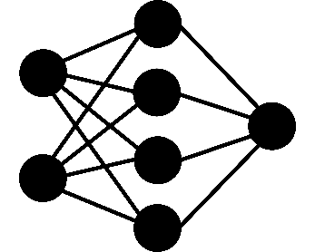

Model V. 1.0 (Prior Work)
Prediction
Concatenate terms into one string
Tokenize and embed
Get contextualized embedding
Inject features (lexical, distributional, and semantic)
Includes structural information
Predict quality using MLP head
$$w$$
Feedback
Φ( )
Humira
…
brand_name | class | uses
Humira | TNF inhibitor | rheumatoid arthritis …
Pre-trained LLM
…
“Humira TNF inhibitor rheumatoid arthritis … “

Slide 22
Embeddings Not Aligned With Domain/Task
Prediction
$$w$$
Feedback
Φ( )
Humira
…
Not adjusting embeddings
Pre-trained LLM
Fine-tuning = expensive;
Update LLM weights
Not fit for short-run
…

Slide 23
Prefix Tuning: Tuning for Domain and Task
Prediction
$$w$$
Feedback
Parameter-efficient approach:
p “prompts” (continuous vectors):
…
Φ( )
Humira
…
Prepend onto pre-LLM input
Learned contextualization
Pre-trained LLM
…
…

Slide 24
Structure Introduced Too Late!
Prediction
$$w$$
Feedback
Φ( )
Humira
LLM does not “know” about structure
…
Pre-trained LLM
…
…

Slide 25
Attribute Encoding: Fusing Structure with Input
Prediction
$$w$$
Feedback
Each attribute (column) encoded as a vector
brand_name | class | uses
Φ( )
Humira
…
b
c
u
Add to pre-LLM input (depending on origin)
Pre-trained LLM
…
…
+
+
+
…
b
c
u

Slide 26
Empirical Study Setup
Dataset | Source | Desc. | #entities
Drugs | Local | Drug reviews | 13,725
 | External | Wikipedia summaries of drugs | 46,976
WDC | Local | Products | 57,109
 | External | Products | 55,247
ChEBI | Local | Molecular information specific to drugs | 5,483
 | External | Molecules and their effects on living organisms | 189,467
CORD-19 | Local | Abstract | 250,575
 | External | Title, authors, etc,. | 340,826
Run simulations over variety of domains
Ground truth = feedback
LLM = Longformer
QUESTION:
Does attribute encoding help?
Does prefix-tuning help?

Slide 27
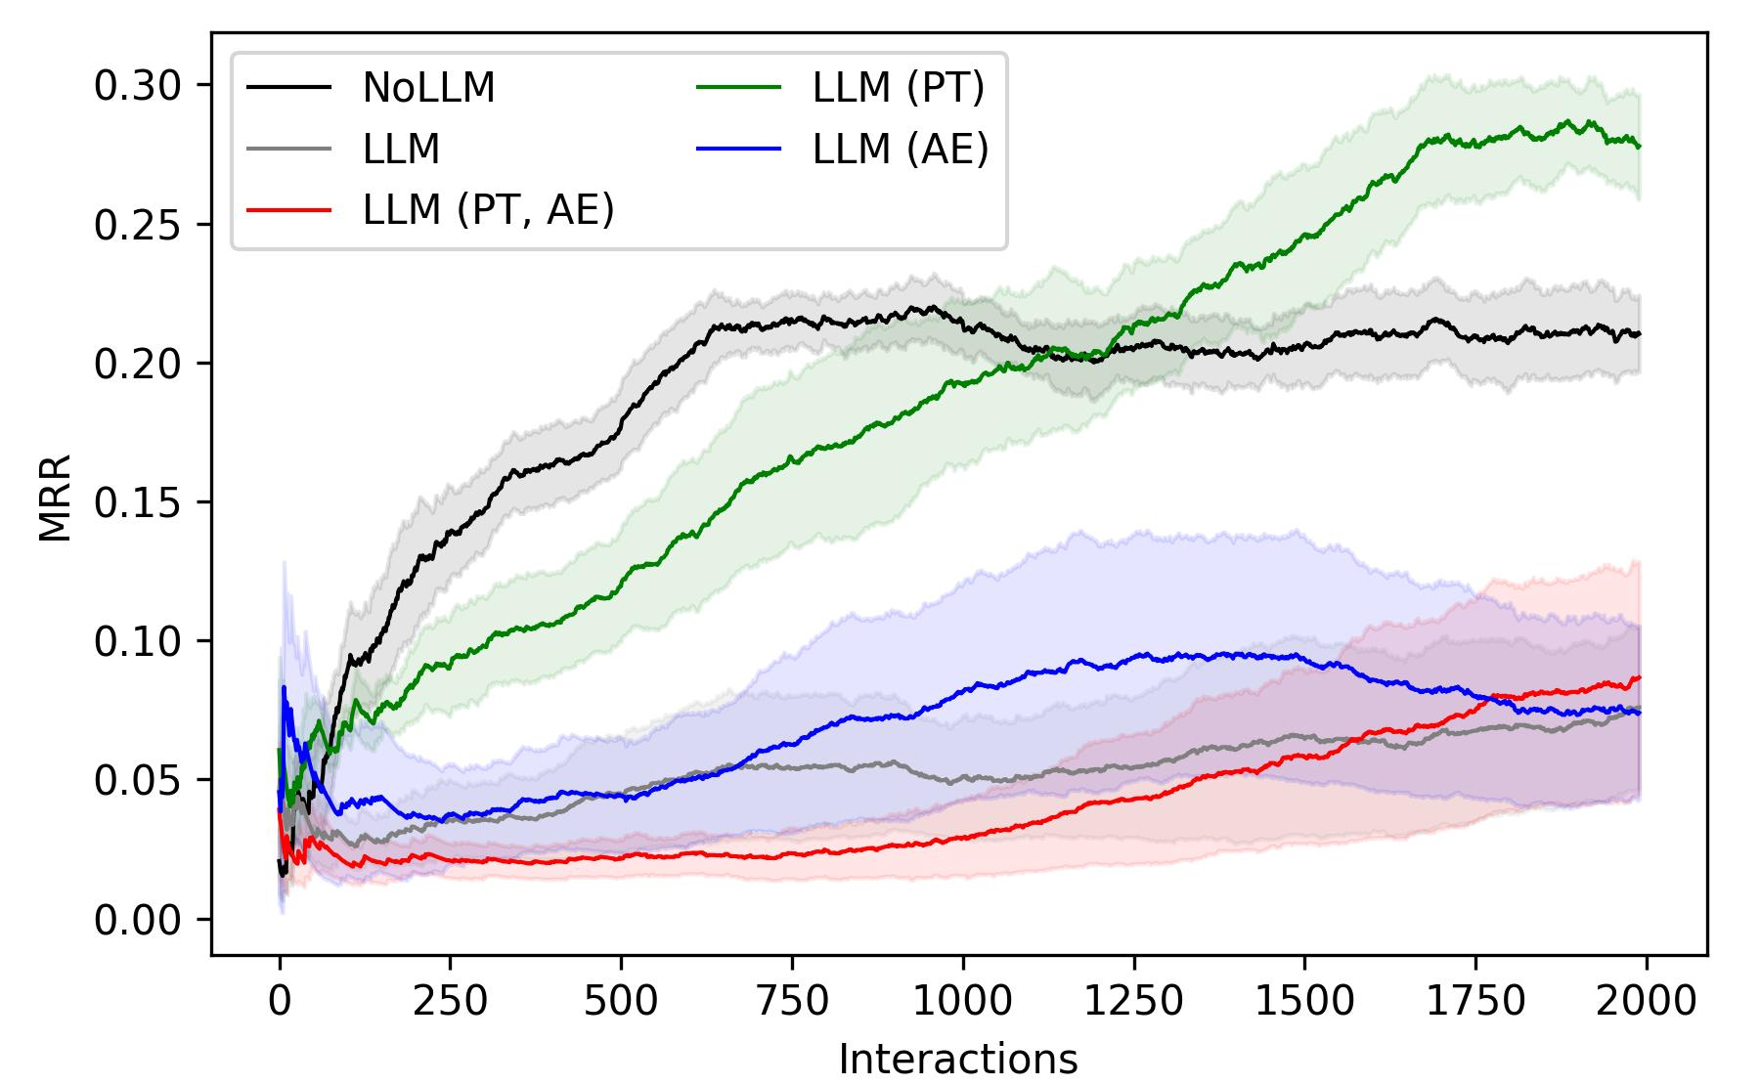
Comparing Enhancements: CORD-19
MRR (last 500); 80% CI
Amount of Feedback

Slide 28
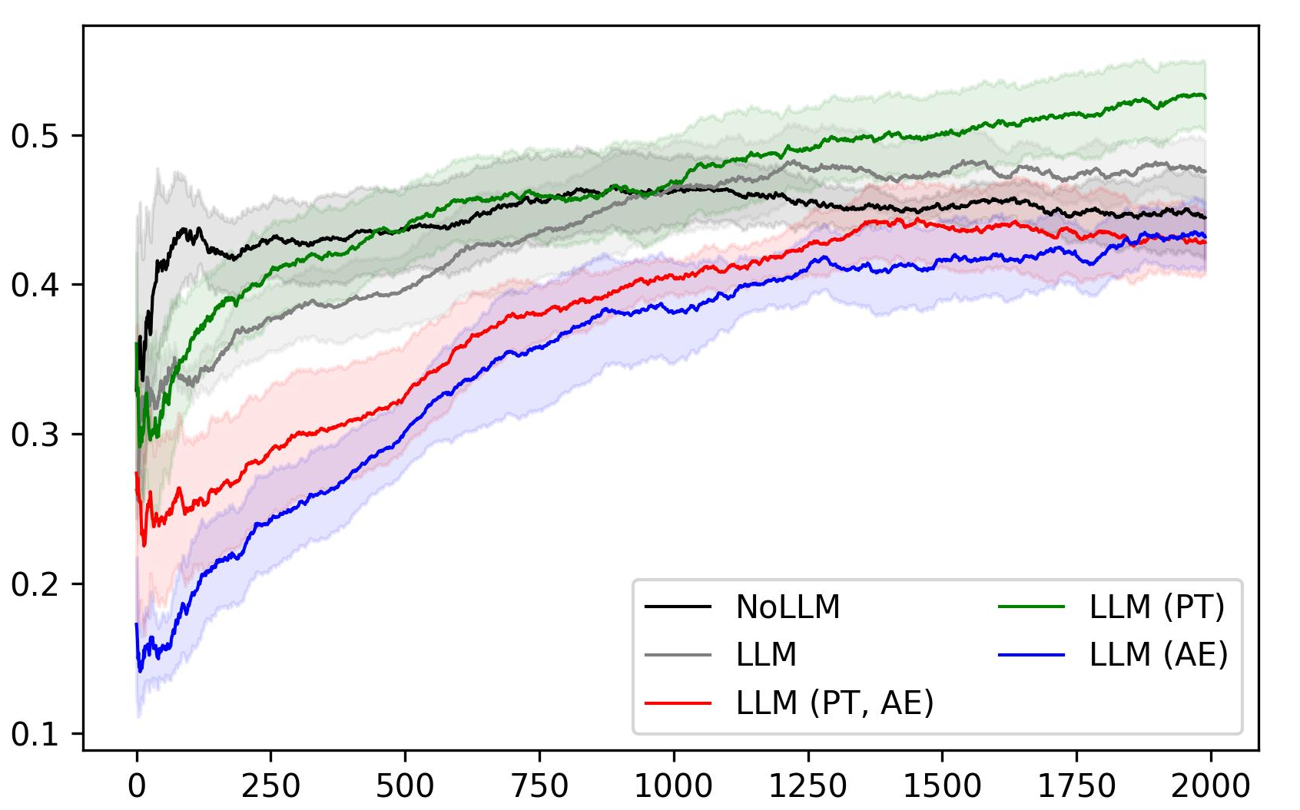
Comparing Enhancements: WDC
MRR (last 500); 80% CI
Amount of Feedback

Slide 29
Future Work
Better fuse domain-specific knowledge with pre-LLM input
Generate structured queries (SQL, graph-based)
Weakly supervised semantic parsing + Short-run challenge = very hard!!
LLMs have strong performance for few-shot learning
Strong prior for complex queries

Slide 30
Takeaways
Motivation/Setup
Enhancements
Experiments
Mediators require a lot of resources to build/maintain by hand
Learn the mediator online using user feedback!
Pre-trained LLM (V. 1) prior
Enhancements:
Prefix-tuning
Attribute encoding
Prefix-tuning beats or meets V. 1 performance
Attribute encoding may degrade performance

Slide 31
Thank you!
49th International Conference on Very Large Data Bases
Please share your questions!

Slide 32
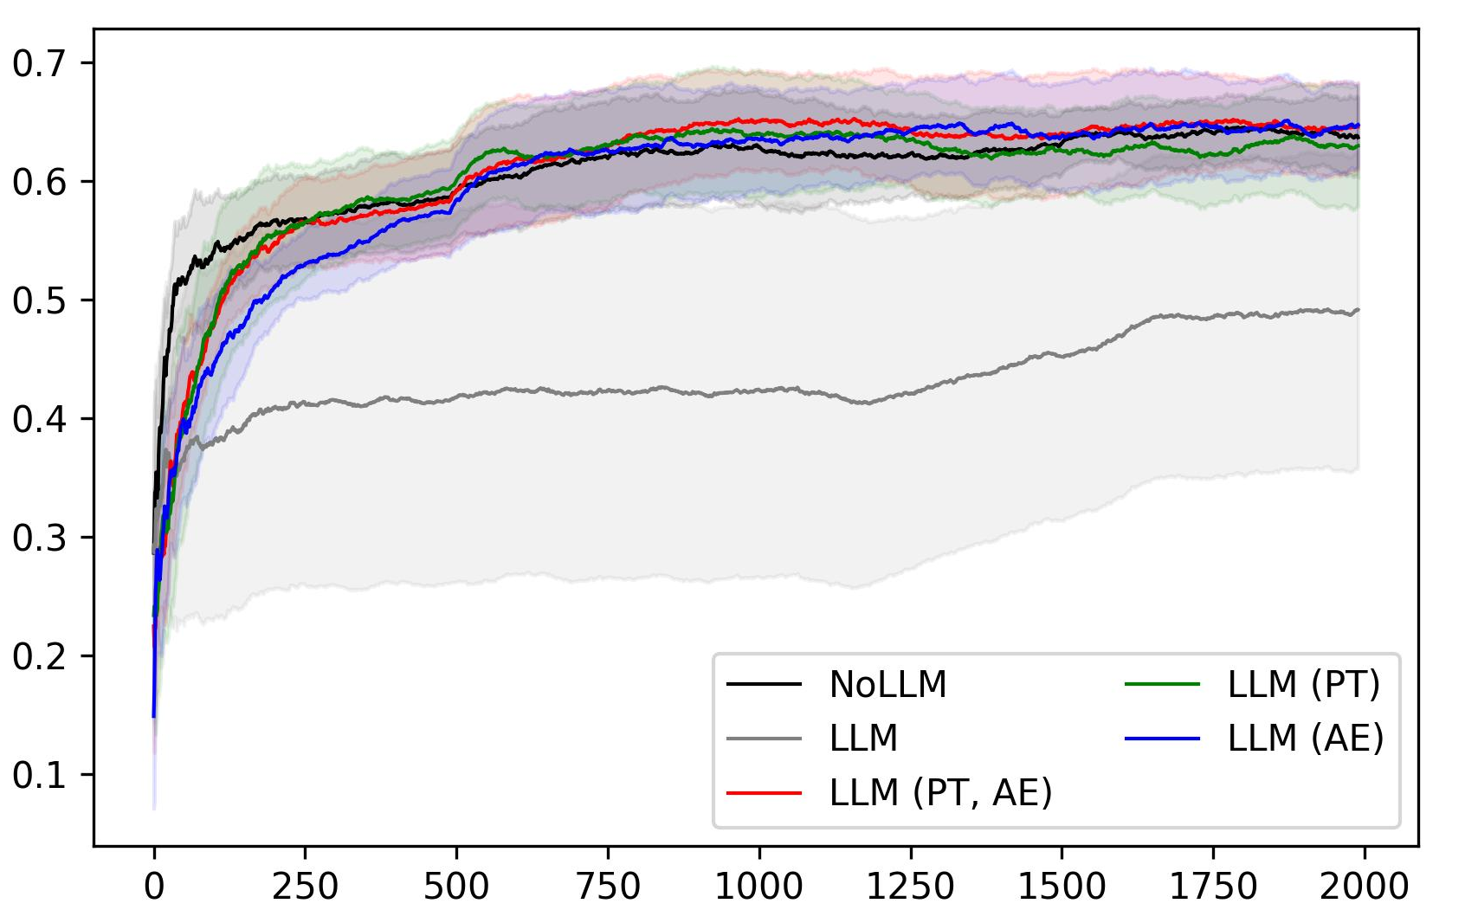
Comparing Enhancements: ChEBI
MRR (last 500); 80% CI
Amount of Feedback
Notes:
Y-axis: query goodness; average of 5 runs = 95% CI
X-axis
RareTerms
They all beat benchmark
Do pretty well in the start
Weird: no real improvement in hybrid over dataset-level
…So we ran some more experimnents

Slide 33
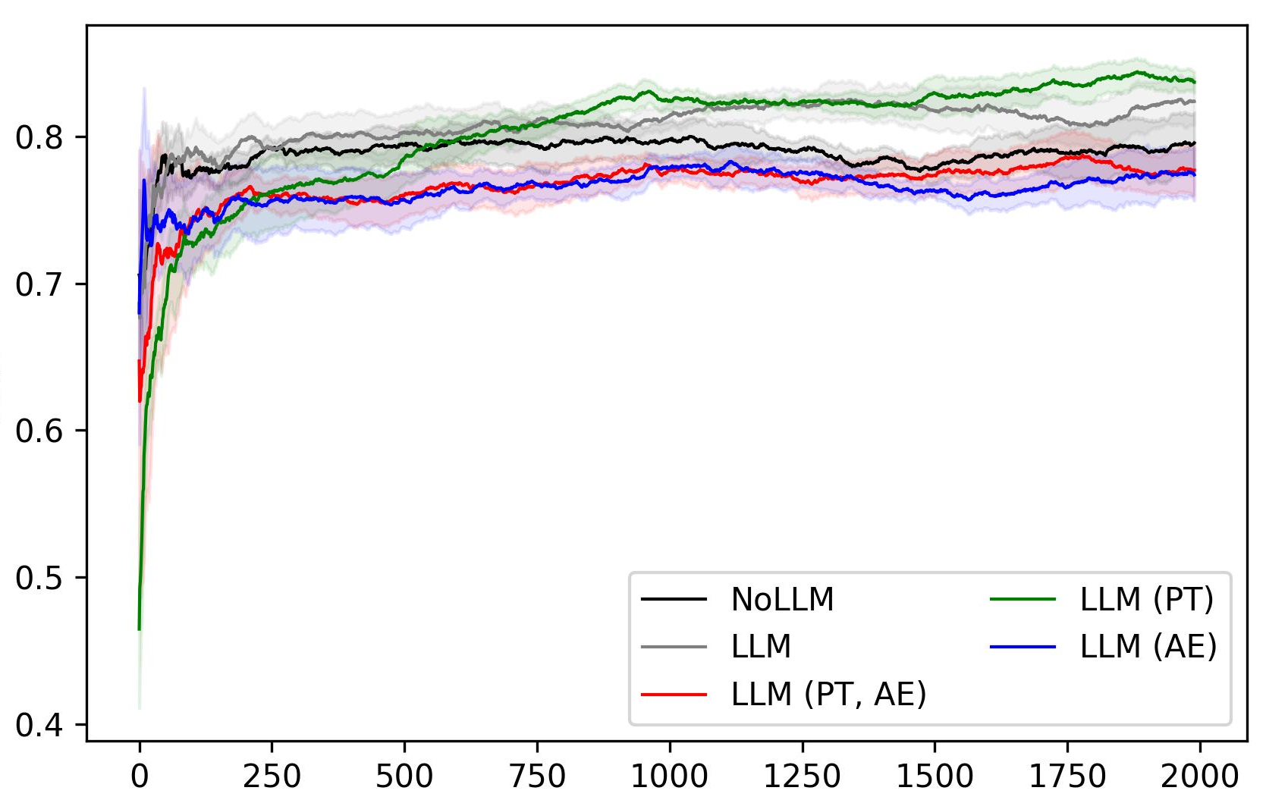
Comparing Enhancements: Drugs
MRR (last 500); 80% CI
Amount of Feedback
Notes:
Y-axis: query goodness; average of 5 runs = 95% CI
X-axis
RareTerms
They all beat benchmark
Do pretty well in the start
Weird: no real improvement in hybrid over dataset-level
…So we ran some more experimnents

